Slide 1
Models of the motor system Kinematics and Dynamics
Spring 2025
Opher Donchin

Slide 2
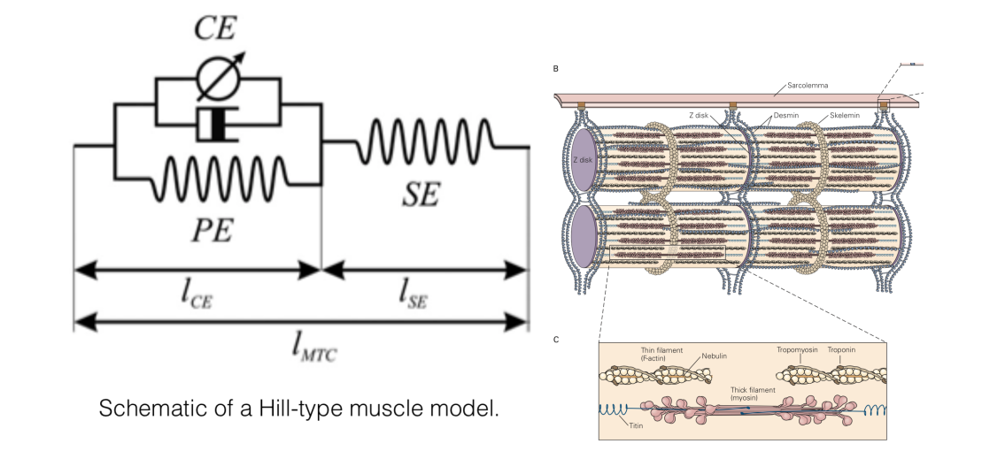
From Muscles to Movement
Last week:
How muscles generate force and torque
Muscle complexity
Hill-type models
Today:
How movements happen when we apply force and torque

Slide 3
Part 1
What is kinematics?
What do you need to know about the arm to find the hand?
What do we mean by “forward kinematics”?

Slide 4
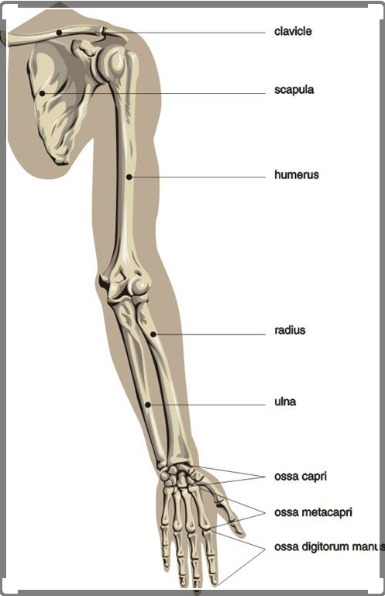
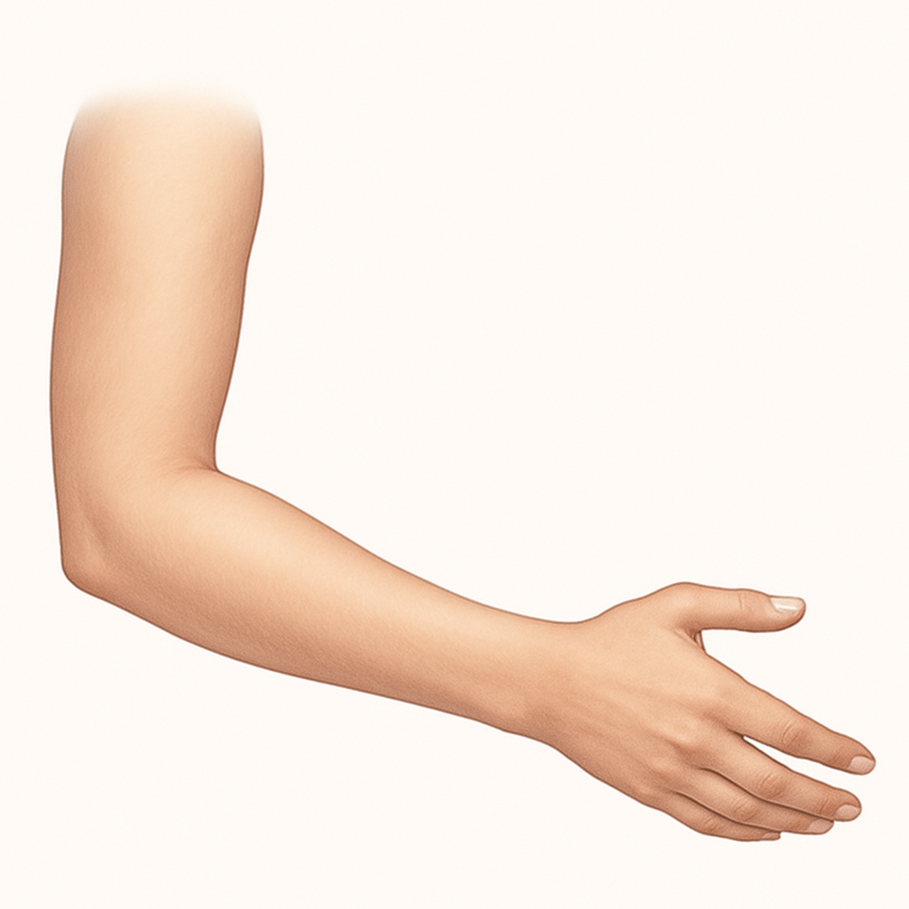
Bones of the human arm
Clavicle
Scapula
Humerus
Humerus
Hand
Radius
Ulna
Elbow
joint
Ulna

Slide 5
Why are joint angles instead of hand position?
Muscles act on joints not endpoints
Joints are where motion is restricted

Slide 6
A 1D model of the bones
Ulna
Hand
Humerus
Elbow joint

Slide 7
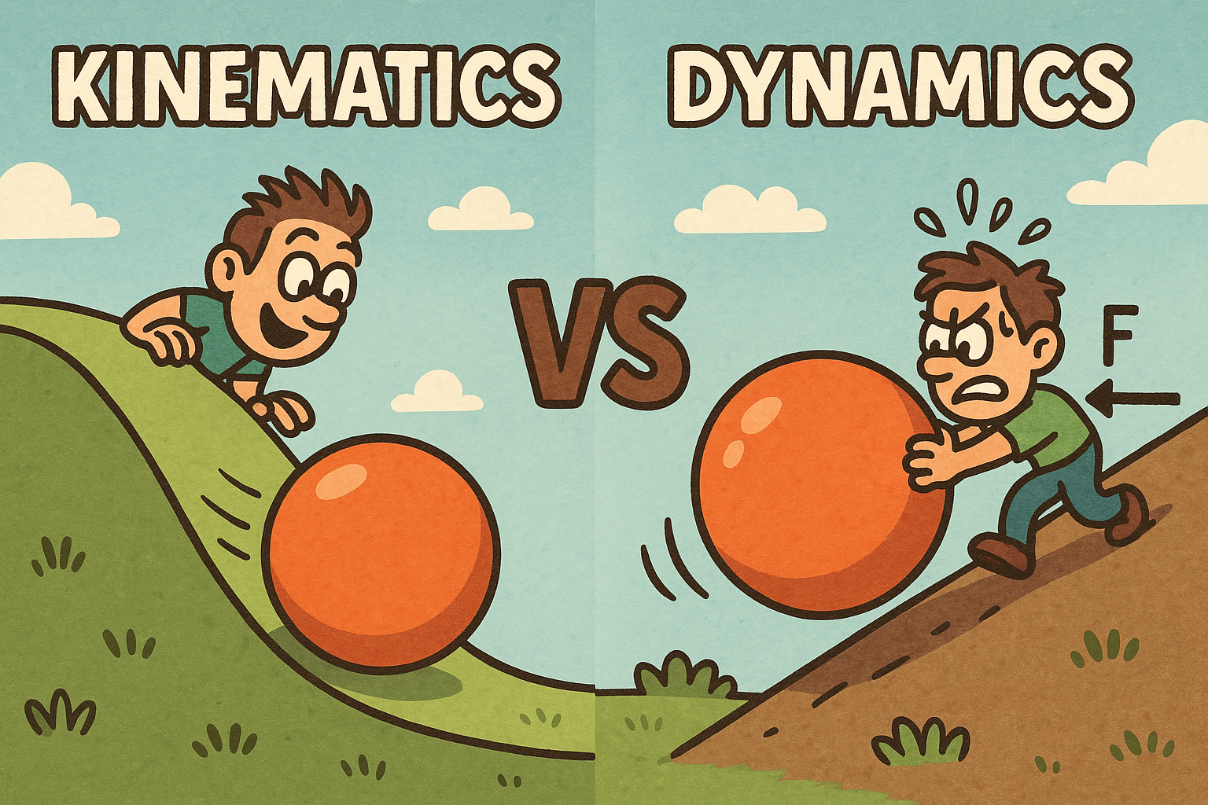
Kinematics vs dynamics: what’s the difference?
Kinematics
Dynamics
Position
Velocity
Acceleration
Linear and angular
Force
Torque
Mass
Inertia

Slide 8
Part 2
Forward kinematics
If I have the joint angles
How do I find the hand?
If I have joint velocity and acceleration
What is hand velocity and acceleration?

Slide 9
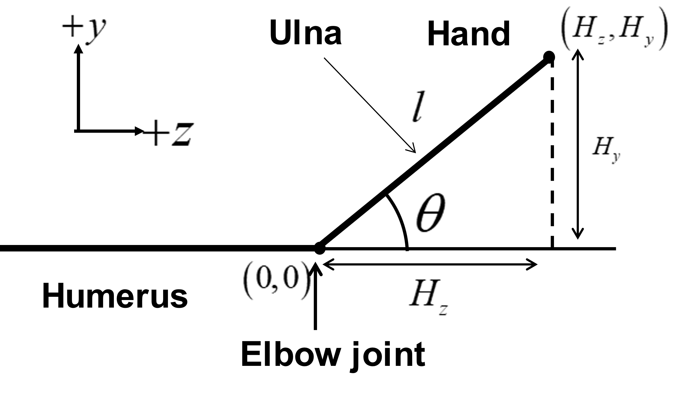
Forward kinematics of position
Position the joints
Where is the hand?

Slide 10
Forward position and velocity
Position the joints
Joint angular velocity gives hand velocity

Slide 11
Forward kinematics full transformation
Position the joints
Joint angular velocity and acceleration
Give hand velocity and acceleration

Slide 12
Equations for position and velocity
These equations give us hand position and velocity for any angular position and velocity

Slide 13
Vectorized equations

Slide 14
From forward kinematics to a Jacobian
The Jacobian is the derivative of hand position with respect to joint angle

Slide 15
Defining velocity in terms of the Jacobian
Defining the Jacobian

Slide 16
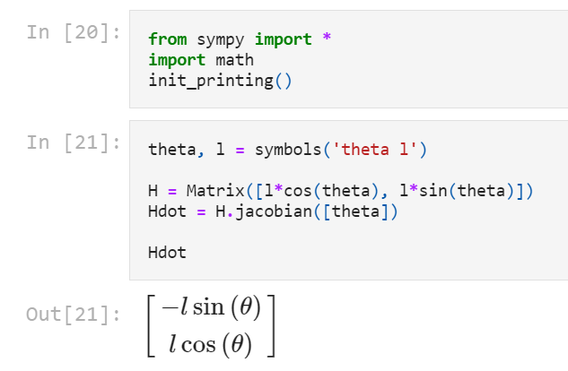

Generating a Jacobian symbolically
Using sympy.diff to compute ${∂H}/{∂θ}$

Slide 17
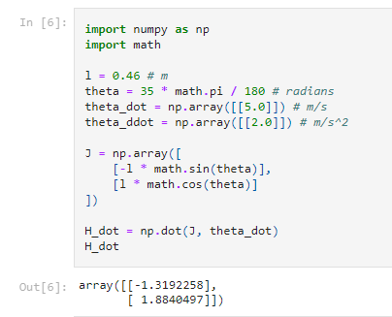
Numerically evaluating symbolic derivative
Symbolic processing →
Substitute values→
Evaluate symbolic prerocesing→
Get numbers

Slide 18
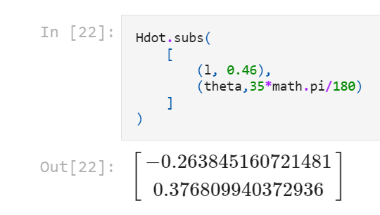
Getting numerical answers from sympy

Slide 19
Acceleration
We need the derivative of the Jacobian
Acceleration is the derivative of the velocity

Slide 20
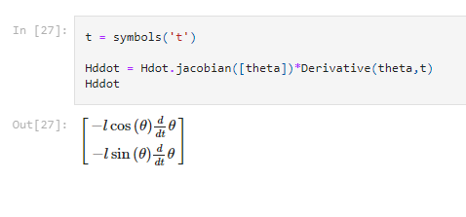
Symbolic derivative of jacobian

Slide 21
Numerical acceleration

Slide 22
Part 3
Inverse kinematics
What joint angles will bring the hand to the right place?
How fast should I get there?

Slide 23
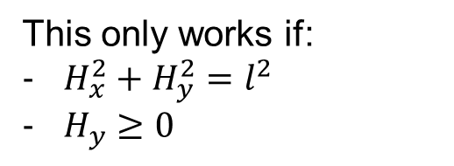
Inverse kinematics: position
I have position of the hand
What are the joint angles?
This only works if:
$H_{x}^{2}+H_{y}^{2}=l^{2}$
$H_{y}≥0$

Slide 24
Inverse kinematics: angular velocity

Slide 25
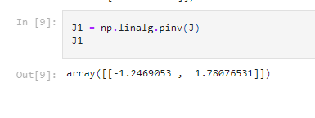
Numeric pseudo-inverse
theta_dot = np.linalg.pinv(J) @ H_dot

Slide 26
Inverse kinematics: angular acceleration
Inverse acceleration is unstable and sensitive to noise!

Slide 27
Part 4
Kinematics in 2D
How do inverse kinematics get harder when we move to 2D?

Slide 28
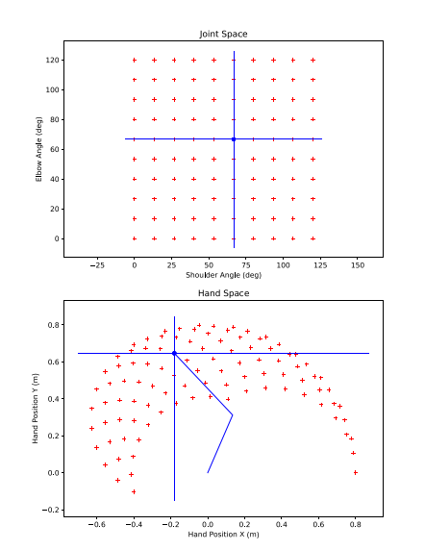
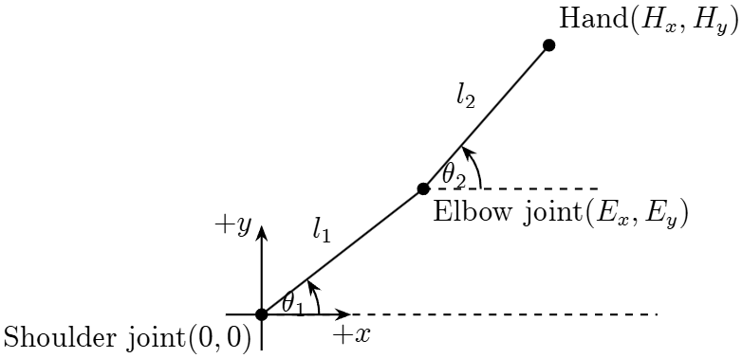
2D model of arm

Slide 29
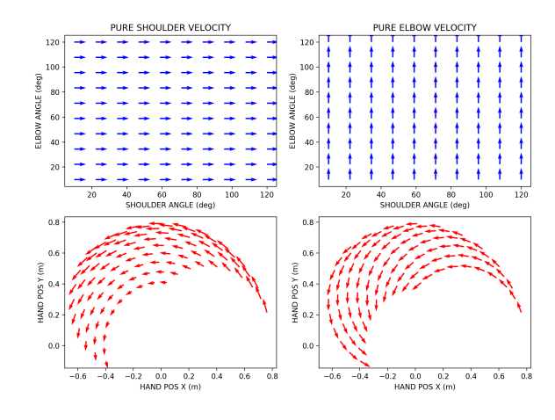
2D Velocity
x position
y position
shoulder angle
elbow angle

Slide 30
2D Acceleration
Changing Jacobian
Joint acceleration
Two components of acceleration

Slide 31
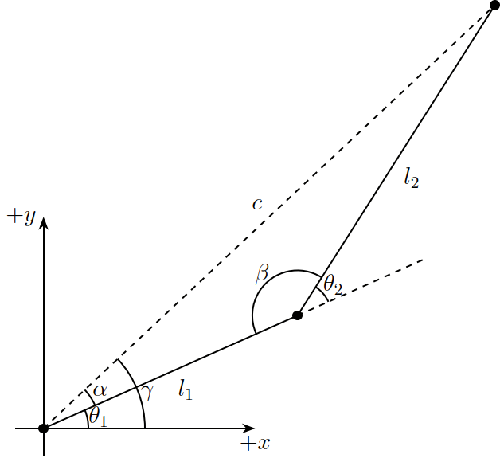
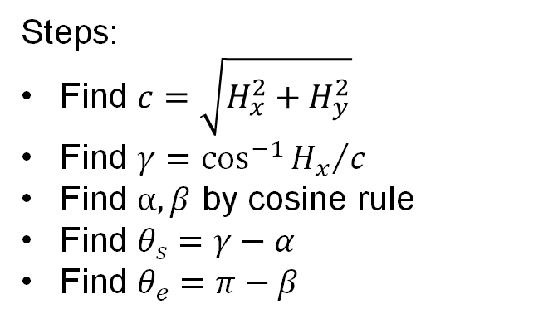
2D Inverse kinematics
Steps:
Find $c=\sqrt{H_{x}^{2}+H_{y}^{2}}$
Find $γ=\cos^{−1}{{H_{x}}/c}$
Find $α,β$ by cosine rule
Find $θ_{s}=γ−α$
Find $θ_{e}=π−β$

Slide 32
2D inverse velocity and acceleration

Slide 33
Part 5
Redundant degrees of freedom

Slide 34
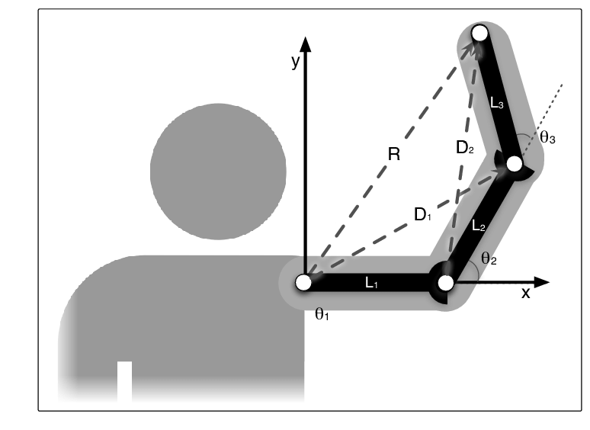
2D arm with three degrees of freedom
The body has redundant degrees of freedom
Kinematics don’t have unique inverse

Slide 35
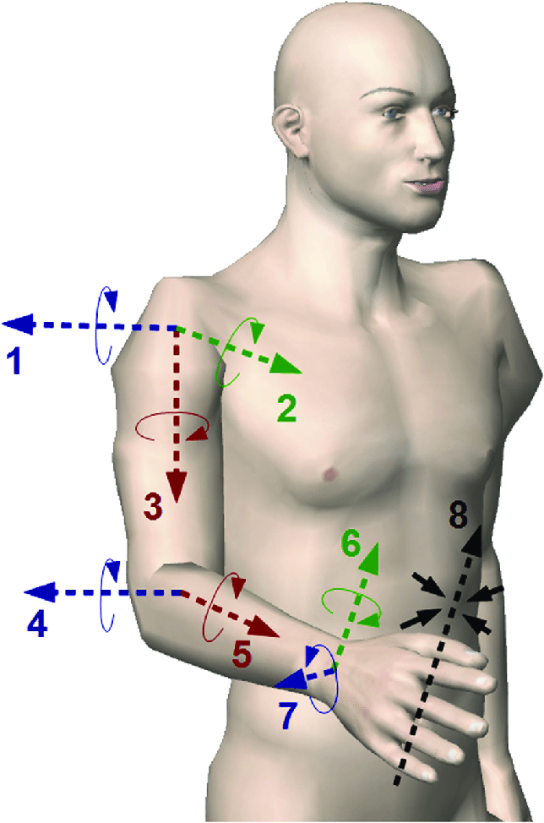
3D arm with redundant degrees of freedom
7 degrees of freedom
3 in shoulder
2 in elbow
2 in wrist
Also
Shoulder translation
Finger degrees of freedom

Slide 36
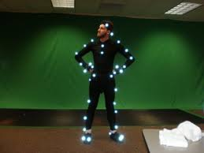
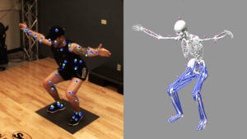
Experimental consequence of redundant DOF
Must measure joints to know them
Marker based
Markerless

Slide 37
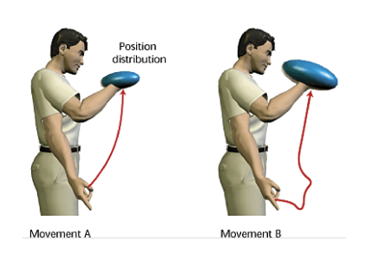
Theoretical consequences of redundant DOF
Infinite ways to do each movement
How does the brain decide?
Minimum jerk?
Minimum endpoint variance?

Slide 38
Part 6
Dynamics in 1D
Where the motion comes from

Slide 39
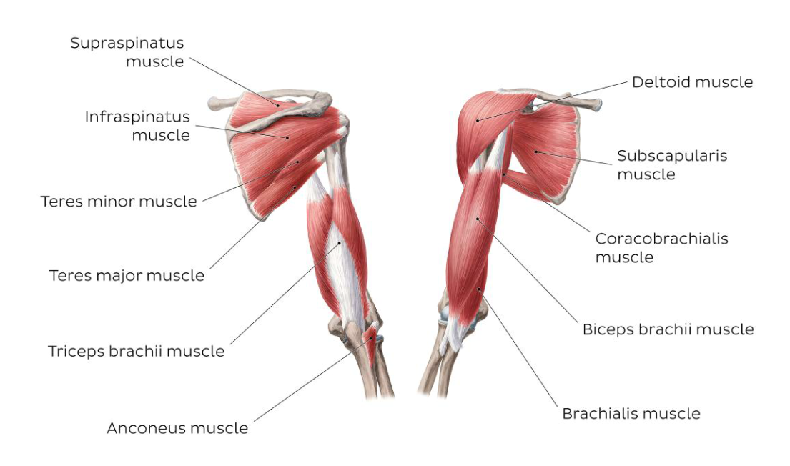
Muscles of the human arm

Slide 40
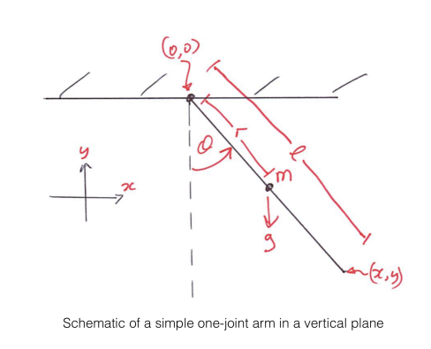
What are dynamics
A straight arm hanging off of the shoulder

Slide 41
The Langrage-Euler Equation
Keeping energy minimized means:
For us:
To find the torque we need to know potential and kinetic energy

Slide 42
Kinetic energy
Rotational kinetic energy
Linear kinetic energy

Slide 43
Potential energy

Slide 44
Lagrangian

Slide 45
Apply Euler-Lagrange

Slide 46
Dynamics
Inverse dynamics
Forward dynamics

Slide 47
Dynamics
Inverse dynamics
Forward dynamics

Slide 48
Part 7
Dynamics in 2D

Slide 49
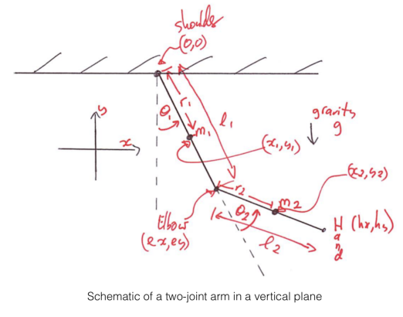
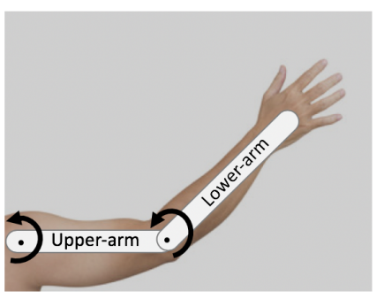
Two joint arm dynamics

Slide 50
Two joint arm dynamics

Slide 51
Kinetic energy

Slide 52
Potential energy

Slide 53
Euler-Langrage

Slide 54
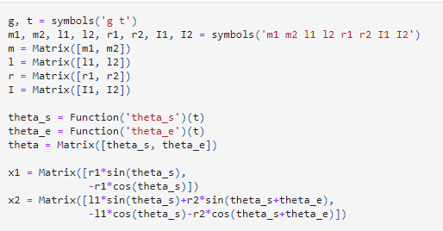
Symbolic python for Euler-Langrage
Set up positions for centers of mass

Slide 55
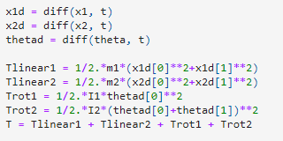


Symbolic python for Euler-Langrage
Kinetic energy depends on first derivatives
Potential energy depends on position
Lagrange depends on both

Slide 56

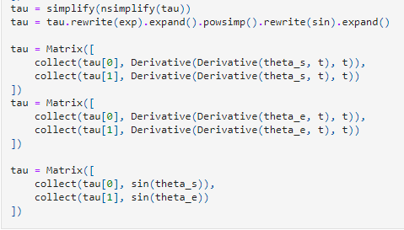
Symbolic python for Euler-Langrage
Can now use the Euler-Lagrange equation to find equation for torque
All this code is just efforts to simplify the equation

Slide 57
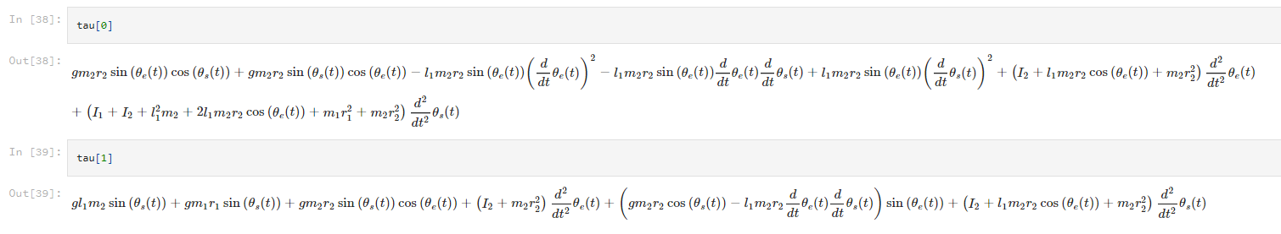
Equation for torque
Python crunches the equations and produces the equation

Slide 58
Simplify using matrix notation

Slide 59
Invert for forward dynamics

Slide 60
Online simulations
Popular problem in robotics
http://bencaine.me/maddux/tutorial.html
https://www.moorepants.info/blog/npendulum.html

Slide 61
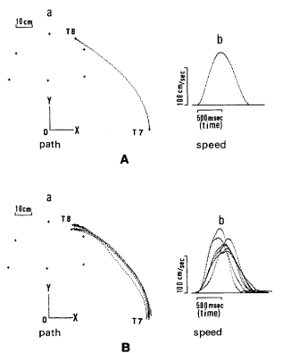
Dynamics and the brain
Alternative to kinematic optimization
Minimize
Joint moments or change in them
Muscle activity or changes
Energy
Uno Biological Cybernetics 1989 doi:10.1007/BF00204593

